Slide 1
The relationship between car sales and economy
Yu-Zhe Gao
Stat, NCU
1/11/2011

Slide 2
Outline
Introduction and Motivation
Data
Method
The Proposed Model
Conclusions
References

Slide 3
Introduction and Motivation
Car is a convenient transport and most people would like to have a car
The relationship between car sales and economy (unemployment rate)

Slide 4
Data
Record of car sales by month in Taiwan from 2005 to 2009
Record of Unemployment rate by month in Taiwan from 2005 to 2009

Slide 5
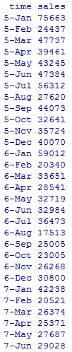
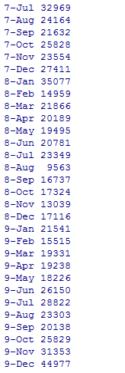
Car sales

Slide 6

Unemployment rate

Slide 7
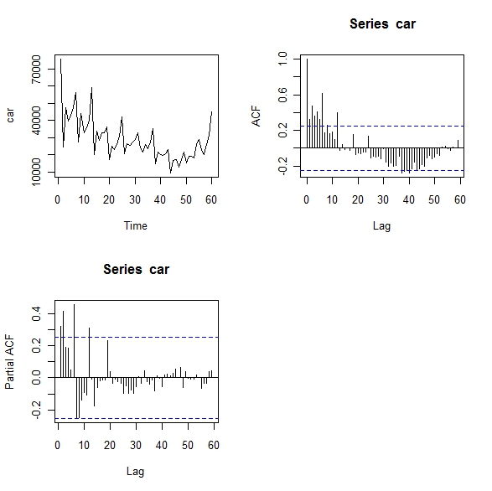
Original data of car sales

Slide 8
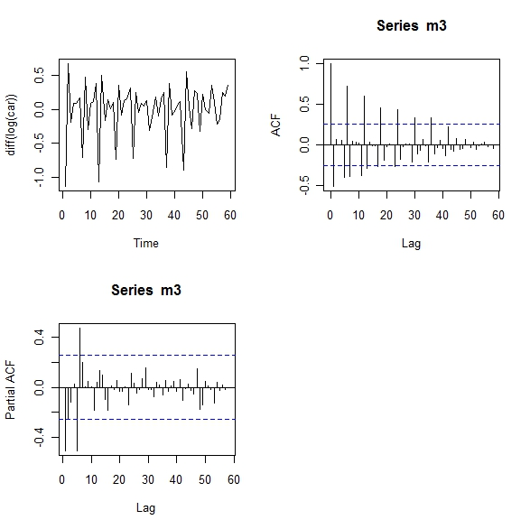

Slide 9
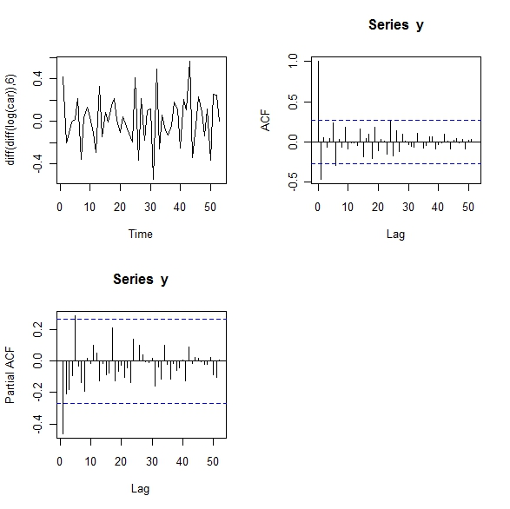

Slide 10
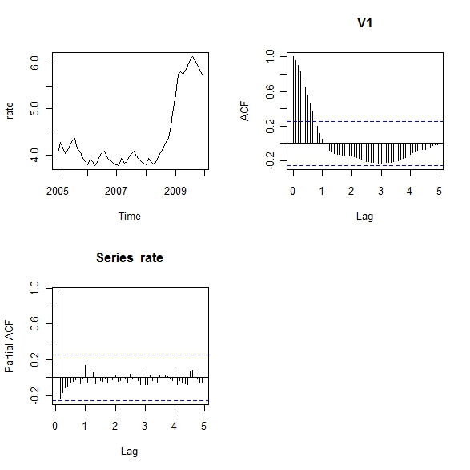
Original data of unemployment rate

Slide 11
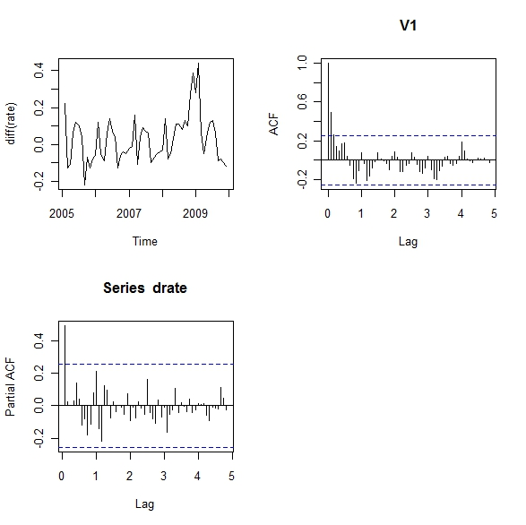

Slide 12
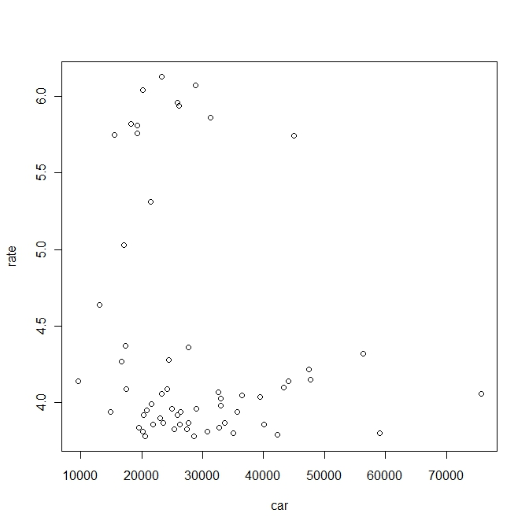
Scatter plot

Slide 13
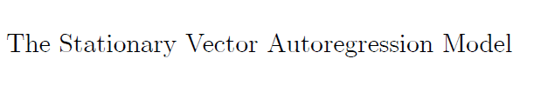
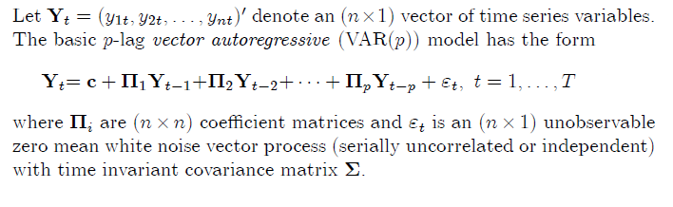
Method

Slide 14
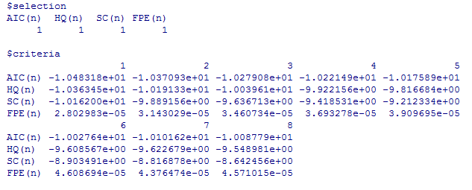
Model selection
Hence, choose p=1 !

Slide 15
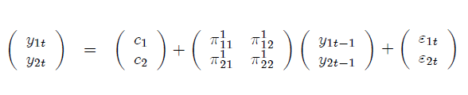
VAR(1) model

Slide 16
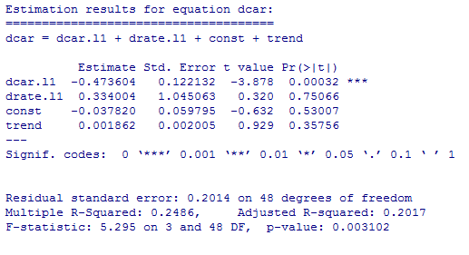
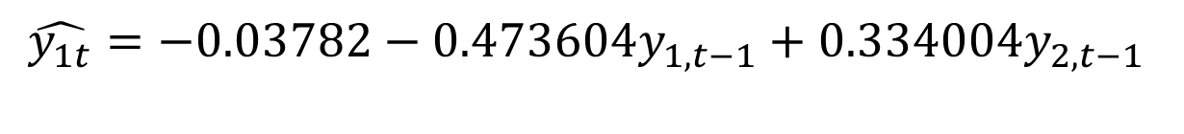
The Proposed Model

Slide 17
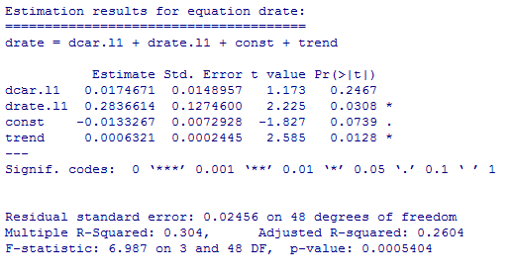
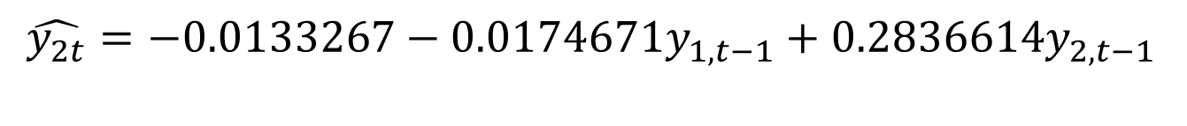
The Proposed Model

Slide 18
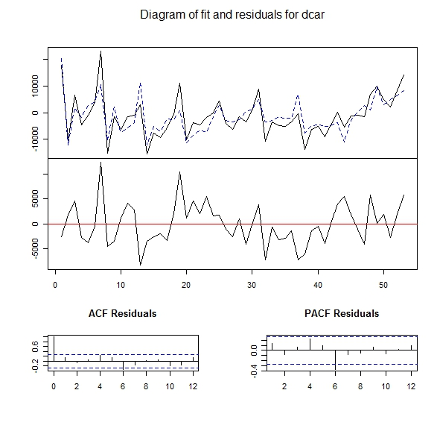

Slide 19
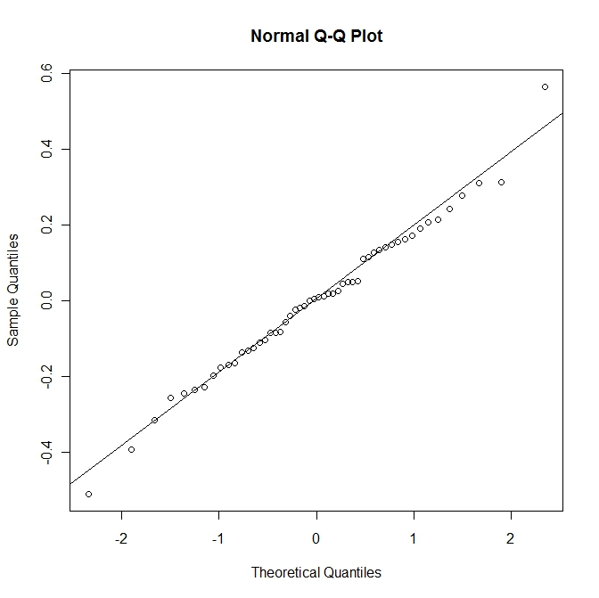

Slide 20
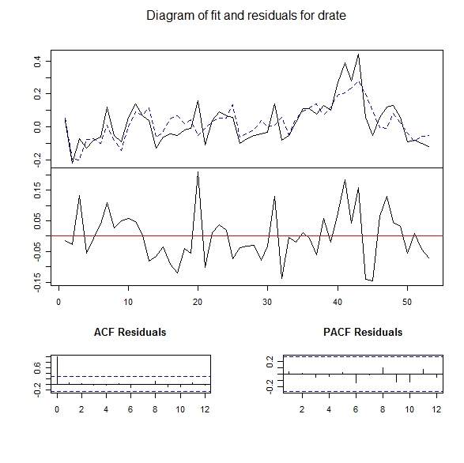

Slide 21
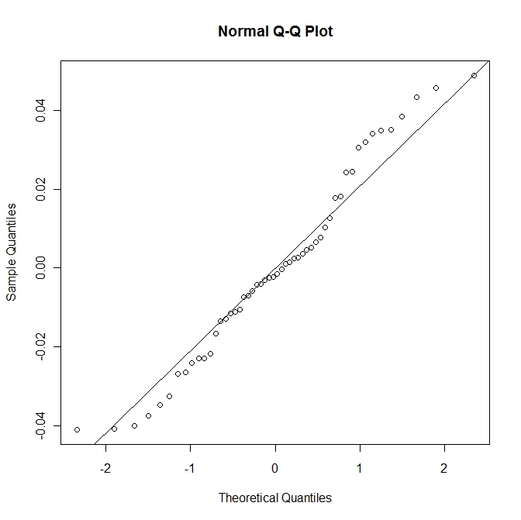

Slide 22
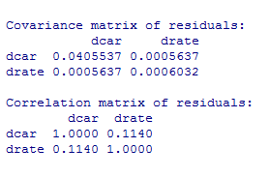
Covariance matrix

Slide 23

Conclusions
The proposed model
Maybe car sales not directly related to unemployment rate

Slide 24
Future work
Learning more financial knowledge
Learning more statistical techniques
  Model
  Variable selection
  Test
  Prediction

Slide 25
References
Http://www.wretch.cc/blog/tivo168/21221110
http://porsche0806.pixnet.net/blog/post/22282725
http://news.u-car.com.tw/news-detail.asp?nid=11601
http://www.dgbas.gov.tw/mp.asp?mp=1

Slide 26
Thank you

