Slide 1
The Price Relationship Study of Stock
You-Sheng Liu
2011/01/04

Slide 2
Outline
1. Motivation
2. Proposed method
3. Data analysis
4. Conclusions

Slide 3
Motivation & Introduction
Because I’m doing on the asset allocation between the stock price in my thesis, I want to know each other impact between.
Prior to the classroom with the AR model can only know the current relationship with the previous period.
This article by Vector Autoregressive Model (VAR) to explore Taiwan Semiconductor Manufacturing Company (TSM)、Uni-President Enterprises Corporation(UPE) of the causal relationship.

Slide 4
Proposed method
VAR model
Granger Causality test
data
1.unit root test
2. co-integration test
VEC model

Slide 5
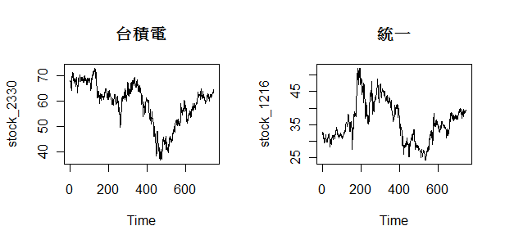
Data
Data:
Daily closing price from 2007.1 to 2009.12

Slide 6
Co-integration test
What is co-integration?
Engle and Granger(1987) proposed statistical model, the definition is linear combination of non-stationary time series become stationary
,then we say that the time series of “Cointegration”phenomenon.
Method:
Engle and Granger (1987) proposed a two-stage cointegration test method to be used to determine the non-stationary time series of the cointegration property. The following steps test
(一)Using unit root test for the time series data,
conducted to determine the non-stationary time series.
(二)Using unit root test for residual term.
This means taht

Slide 7
VAR model
Suppose we have 2 time series , i = 1,2 , m,and t = 1, . . . , T. Then a vector autoregression modelis defined as
In matrix notations

Slide 8
VEC(vector error correction ) model
In matrix notations
The previous period error term of the cointegration model

Slide 9
Granger Causality test
: X does not cause Y
(Or : β1 =β2 = …. = βm = 0; from the following model:
Yt= Σαi Yt-i+ Σβi Xt-i+εt )

Slide 10
Data analysis
Unit root test:
 | 台積電 | 統一
origin | 0.7072 | 0.8947
Difference(1) | < 0.05 | < 0.05
Co-integration test:
 | 台積電v.s統一
P-value | 0.0167

Slide 11
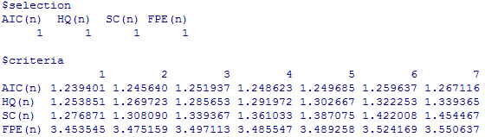
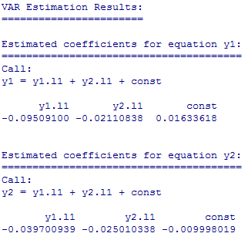
Data analysis
The choice of lag:
Parameter estimate:

Slide 12
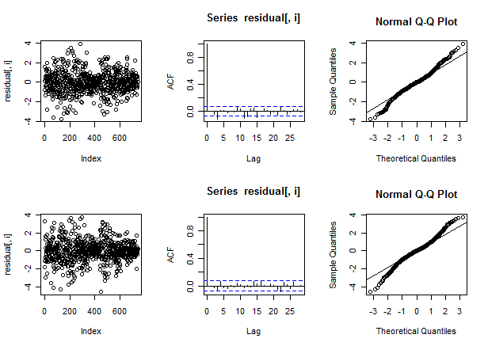
Data analysis

Slide 13
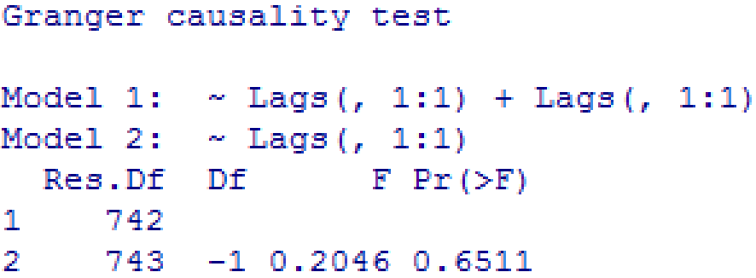
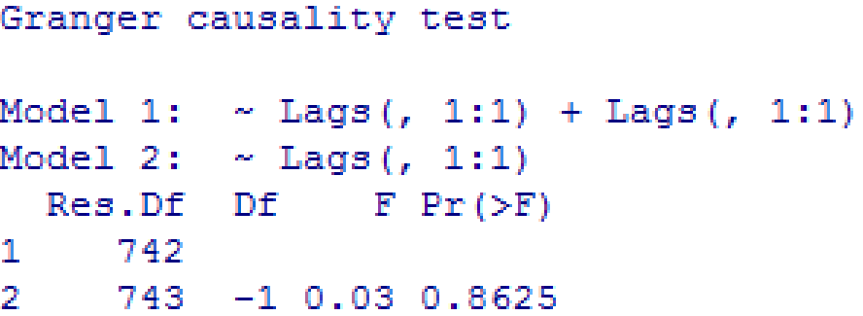
Data analysis
: Y does not cause X
: X does not cause Y

Slide 14
Conclusions
1.The model fit:
2. So when I was doing asset allocation,
I would have taken into account these two stocks.

Slide 15
Reference
台灣證劵交易所: http://www.twse.com.tw/ch/

Slide 16
Thank you \0.0/

