Slide 1
Spikes of the Electricity
Reporter: You-Cheng Luo
2011/01/04

Slide 2
Outline
Review on the data
(http://www.eia.doe.gov/cneaf/electricity/wholesale/wholesale.html)
Review on Propose Methods
Parameter Estimation
Result
Conclusion & Future Work

Slide 3
Review on the data
The first data is the delivery date from 2009/01/05 to 2010/11/15 in the Ercotsouth which is a main trade hub in Texas.
The second data is the delivery date form 2009/01/07 to 2010/11/10 in the PJM West which is a main trade hub in Pennsylvania.
The prices are computed by WtdAvgPrice $/MWh, where the WtdAvgPrice is

Slide 4
Review on the Proposed Methods
Geman and Roncoroni (2002) introduce a jump-reversion model for electricity spot prices, namely the representation of S(t), by:

Slide 5
Selection of the Structural Element
Mean trend
The first term may be viewed as a fixed cost linked to the production of power. The second one drives the long-run linear trend in the total production cost. The overall effect of the third and fourth terms is a periodic path displaying two maxima per year, of possibly different magnitudes.

Slide 6
Selection of the Structural Element
A probability distribution for the jump size. We select a truncated version of an exponential density with parameter θ₃:
where ψ represents an upper bound for the absolute value of price changes.

Slide 7
Model Parameter Estimation
The constant Brownian volatility over observation dates 0 = t₀ < t₁ <…< t_{n} = t can be obtained as :
where each summand represents the square of the continuous part of observed price variations (in a logarithmic scale) between consecutive days t_{i} and t_{i+1}

Slide 8
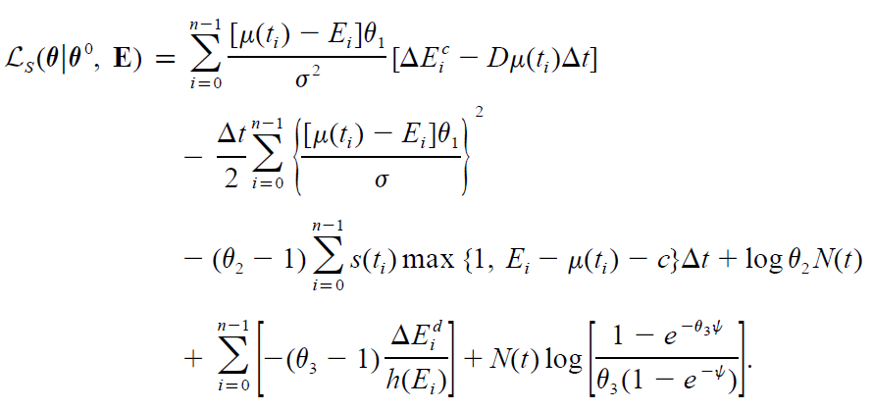
Model Parameter Estimation

Slide 9
Simulation Algorithm
Where N is sample from a standard normal distribution and J is sample from p(‧, θ₃)
for some k=1,…,n

Slide 10
Result
PJM Market

Slide 11
Result
Ercotsouth

Slide 12
Conclusion and Future Work
My simulation is not fitting well about the spikes of the data because of my experiences.
Maybe we can try another models to fit the electricity prices, and then introduce the copula to figure out the dependency between other variables and electricity prices.

Slide 13
References
U.S. Energy Information Administration Independent Statistic and Analysis
http://www.eia.doe.gov/cneaf/electricity/wholesale/wholesale.html
Roncoroni-Geman(2002) ;The Journal of Business Understanding the Fine Structure of Electricity Prices
http://www.globalriskguard.com/resources/enderiv/Roncoroni-Geman.pdf

