Slide 1
Regime switching in oil markets
Han-Ling Yang
01/11/2011

Slide 2
Outline
Motivation & Introduction to the data
Proposed methods
Data Analysis
Conclusions & Future work
Reference

Slide 3
Motivation & Introduction to the data
Motivation-
  The price of crude oil futures contract has the same volatility in the same market ?
  Price volatility
  Government
  Shocks
  Market
  ……….

Slide 4
Motivation & Introduction to the data
NYM-LIGHT CRUDE OIL
  2001/01/01~2010/11/08
NYM-MID EAST SOUR CRUDE
  2001/01/01~2001/08/01
NYM-russian export blend CRUDE OIL(REBCO)
  2008/11/24~2010/11/08
NYM-EMINI LIGHT SWEET CRUDE
  2004/03/22~2010/11/8

Slide 5
Time series plot for the data

Slide 6
Proposed methods
Cutting
Regime switching vector autoregressive models
(MS-VAR)

Slide 7
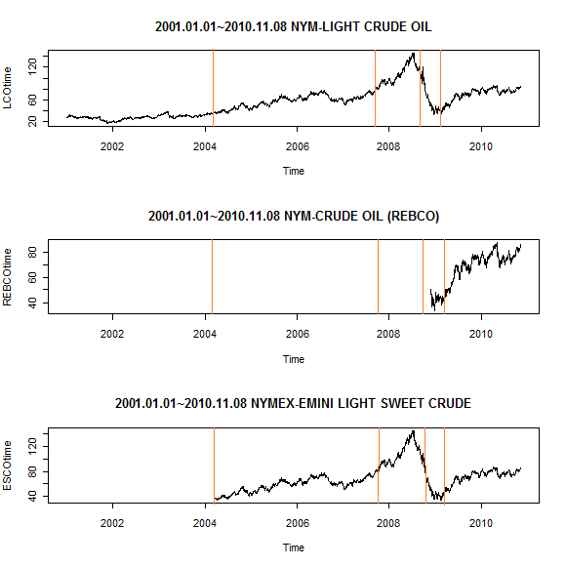
Proposed methods
Cutting
  2001.01.01~2004.03.19
  2004.03.22~2007.07.31
  2007.08.01~2008.08.29
  2008.09.01~2009.02.27
  2009.03.02~2010.11.08

Slide 8
Proposed methods
Regime switching vector autoregressive models
(MS-VAR)

Slide 9
Data Analysis
Cutting
 | 2001.01.01 ~ 2004.03.19 | 2004.03.22 ~ 2007.07.31 | 2007.08.01 ~ 2008.08.29 | 2008.09.01 ~ 2009.02.27 | 2009.03.02 ~ 2010.11.08
LCO | GARCH(0,1) | GARCH(5,0) | GARCH(0,1) | GARCH(5,0) | GARCH(1,2)
REBCO |  |  |  | GARCH(5,0) | GARCH(3,3)
ESCO |  | GARCH(0,6) | GARCH(0,1) | GARCH(5,0) | GARCH(3,3)

Slide 10
Data Analysis
Cutting
 | 2001.01.01 ~ 2004.03.19 | 2004.03.22 ~ 2007.07.31 | 2007.08.01 ~ 2008.08.29 | 2008.09.01 ~ 2009.02.27 | 2009.03.02 ~ 2010.11.08
LCO
REBCO
ESCO

Slide 11
Data Analysis
 |  | LCO | REBCO | ESCO
Lag=1 | Stat=2 | AIC=-12197 | AIC=-2355.4 | AIC=-8275.3
 | Stat=3 | AIC=-12215 | AIC=-2342 | AIC=-8294.8
Lag=2 | Stat=2 | AIC=-12195
 | Stat=3 | AIC=-12215
Lag=5 | Stat=2 | AIC=-12191
 | Stat=3 | AIC=-12196
Lag=7 | Stat=2 |  |  | AIC=-8264.3
 | Stat=3 |  |  | AIC=-8268
Lag=8 | Stat=2 |  | AIC=-2344
 | Stat=3 |  | AIC=-2304.8
MS-VAR

Slide 12
Data Analysis
MS-VAR
  NYM-LIGHT CRUDE OIL

Slide 13
Data Analysis
MS-VAR
  NYM-LIGHT CRUDE OIL

Slide 14
Data Analysis
MS-VAR
NYM-russian export blend CRUDE OIL(REBCO)

Slide 15
Data Analysis
MS-VAR
NYM-russian export blend CRUDE OIL(REBCO)

Slide 16
Data Analysis
MS-VAR
NYM-EMINI LIGHT SWEET CRUDE

Slide 17
Data Analysis
MS-VAR
NYM-EMINI LIGHT SWEET CRUDE

Slide 18
Conclusions & Future work
Conclusions :
  .
Future work :
  Model Selection
  Forecasting ,Simulation
  Regime Switching Model
 | LCO | REBCO | ESCO
Cutting | -19345.3737 | -3767.3811 | -13132.8859
MS_VAR | -12215 | -2355.4 | -8294.8

Slide 19
Reference
Data
  National Central University(Department of Finance)
Some internet webpages
  Markov Regime Switching Models
  http://140.115.153.42:33380/CDA/workshop/Weather_Risk_2010_dec_06.php
  http://zh.wikipedia.org/zh-tw/2007%E5%B9%B4%EF%BC%8D2010%E5%B9%B4%E7%92%B0%E7%90%83%E9%87%91%E8%9E%8D%E5%8D%B1%E6%A9%9F

Slide 20
Thank you !

